Slide 1
HR Analytics Addressing BI4ALL EMPLOYEE ATTRITION
Group EDSB23Q
André Pereira, 20221204@novaims.unl.pt
Francisco Antelo, 20221624 @novaims.unl.pt
Hortense Matos, 20222167 @novaims.unl.pt
Irina Keis, 20222168 @novaims.unl.pt

Slide 2
Agenda
Executive Summary
Employee Attrition indicators
Main Project goals
Team Profile
Factors causing attrition
Employee Attrition rates
Retention Strategies

Slide 3
Executive Summary
Attrition rates are quite high for the BI4ALL Employees
Current attrition rate is 16% which is higher when compared to IT industry rates.
Employees stay an average of 7 years with the company; Of the employees who left, 59.5% of employees have resigned within the first 5 years.
The cost of 1% increase in attrition rate is estimated to be $30,000 USD.
Understanding the team profile: Demographics, Lifestyle and Career development traits of employees
The average employee is a Male, Married and 37 years old.
Regarding Lifestyle, most employees do not do overtime, travel rarely on business, live close to the office and consider having a Good/Excellent work-life balance.
In terms of Career development, 69% of the company’s employees feel involved in their respective roles, while 61% display high to very high levels of job satisfaction.
Analyzing the main factors that contribute to the employee’s decision to leave the company shows three main insights:
Monthly Income, Age and Marital Status seem to describe a younger employee type who is likely to change in the first years of their career.
Monthly Income, Hourly Rate, Daily Rate and Stock Option level demonstrate the importance of compensation in the attrition rate levels.
Finally, Business Travel, Over Time and Distance from Home reflect the work-life balance axis that influence the decision to keep with the company or leave.
Developing and deploying a model that predicts Attrition
A high Recall was prioritized, but without disregarding Precision and F1-Score. The higher the Recall, the lower the number of False Negatives – Employees that will leave when the company thinks they will stay.
Four supervised models were tested (Logistic Regression, Support Vector Machine, XGBoost, and Random Forest), with Logistic Regression having the best performance.
In a Test set of 294 employees, this model was able to predict 28 of the 39 cases of Attrition, giving it a Recall of 0.72, with only 11 cases of false negatives.
Employee retention is significantly impacted by talent management strategies implemented by companies. Based on the factors that influence the attrition rate, we propose several strategic employee retention methods:
Targeting the Younger employee profile most likely to quit in the first years of their career:
Training and Development: identify training needs and provide appropriate training and defining Young Talent programs, targeting the younger employee profile.
Career development plan: define career development plans to provide possible career trajectories. Identify high-potentials that could assume future leadership roles.
Offering competitive base salaries or hourly wages is an essential factor in retaining employees
Compensation: provide attractive compensation packages to increase overall job satisfaction.
Benefits: offer benefits such as company provided-lunches, on-site parking, free day on employee birthday and flexible work schedules.
Employee retention is greatly influenced by initiatives that supports a good work-life balance:
Work life Balance: implement working from home and flexi-time, allowing employees to balance their personal and professional life.
Positive Work Environment: Build a positive workplace culture, which values flexibility, support personal responsibilities and encourages a good work-life balance. Foster open communication, collaboration and respect among employees.

Slide 4
Employee Attrition Indicators
Key indicators companies should consider regarding employee attrition
ATTRITION
TENURE
RESIGNATION
COSTS
The rate of employee turn-over⁽¹⁾ has increased in the recent years, most significantly in the post-COVID era.
4.1 years is the average tenure of an employee, according to the US Bureau of Labor Statistics⁽²⁾.
Nearly 38% of employees quit within the first year on the job ⁽²⁾.
It costs 33% of an employee’s salary to substitute them⁽²⁾.
(1) Gartner Study; HBR article | (2) Forbes article

Slide 5

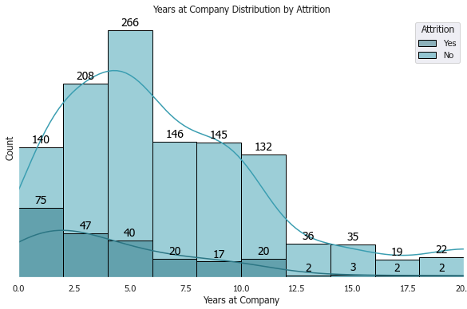
Employee Attrition Indicators
At BI4All, the attrition rate is higher than average, but so is the employee tenure.
Attrition Rate
16,1%
The company displays an attrition rate 3% higher than the IT industry standards of 12,9%⁽³⁾.
The average employee stays 7 years with the company, while most current employees have a tenure of 5 years.
Currently 59.5% of employees have resigned within the first 5 years on the job.
(3) LinkedIn Article

Slide 6

Employee Attrition Indicators
High employee turn-over has direct impact on the company’s costs.
$1,580
$374,399
$30,044
Individual Cost per Employee
Total Cost
(Current Attrition Levels)
Cost of 1% increase in Attrition

Slide 7
Main Project Goals
Team Profile
Main Factors Causing Attrition
Employee Attrition Rate
Retention Strategies
Exploring Demographics, Lifestyle, Career Development
Identify main factors contributing to the employee’s decision to leave the company
Predicting future employee exits
Propose Retention Strategies that can be implemented to target the factors causing attrition

Slide 8

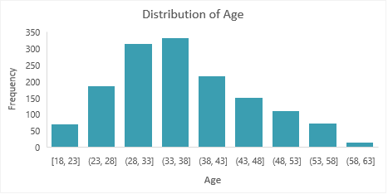
Team Profile: Demographics
Majority of employees are male and married, being on average 37 years old.
At BI4ALL, there are more male than female employees.
The most common marital status of employees is married (46%).
Majority of employees will be between 28 and 38 years old, with the average employee age being 37.
Gender distribution
Female
40%
Male
60%

Slide 9
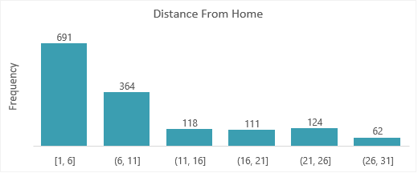
Team Profile: Lifestyle
Most employees do not do overtime, travel rarely on business, live close to the office and consider to have a good work-life balance.
“No” accounts for majority of employees that do overtime.
Only 19% of employees travel frequently on business.
Employees consider to have a positive work-life balance, with 71% considering it as ‘Better’.
Most employees live close to the office, having a short distance from home.

Slide 10
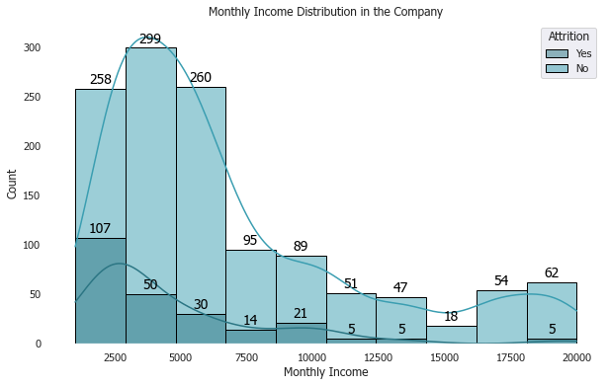
Team Profile: Career development
Most employees show high job involvement as well as a very high job satisfaction, with an average income of $6502.
At BI4ALL, the median monthly income of an employee’s is $4919.
69% of the company’s employees feel highly or very highly involved in their respective roles, while 61% display high to very high levels of job satisfaction.

Slide 11
Main Project Goals
Team Profile
Main Factors Causing Attrition
Employee Attrition Rate
Retention Strategies
Exploring Demographics, Lifestyle, Career Development
Identify main factors contributing to the employee’s decision to leave the company
Predicting future employee exits
Propose Retention Strategies that can be implemented to target the factors causing attrition

Slide 12



Main factors causing Attrition
Three profiles associated to Employee Age, Compensation and Work Life Balance
Monthly Income, Age, Job Level seem to describe a younger employee type who is likely to change in the first years of its career.
Monthly Rate, Hourly Rate, Daily Rate and Stock Option Level demonstrate the importance of compensation in the attrition rate levels.
Finally, Business Travel, Over Time, Job Involvement, Job Satisfaction, Environment Satisfaction and Distance from Home reflect the work-life balance axis that influence the decision to leave or stay with the company.
(Additional details in back-up slides)

Slide 13
Main Project Goals
Team Profile
Main Factors Causing Attrition
Employee Attrition Rate
Retention Strategies
Exploring Demographics, Lifestyle, Career Development
Identify main factors contributing to the employee’s decision to leave the company
Predicting future employee exits
Propose Retention Strategies that can be implemented to target the factors causing attrition

Slide 14
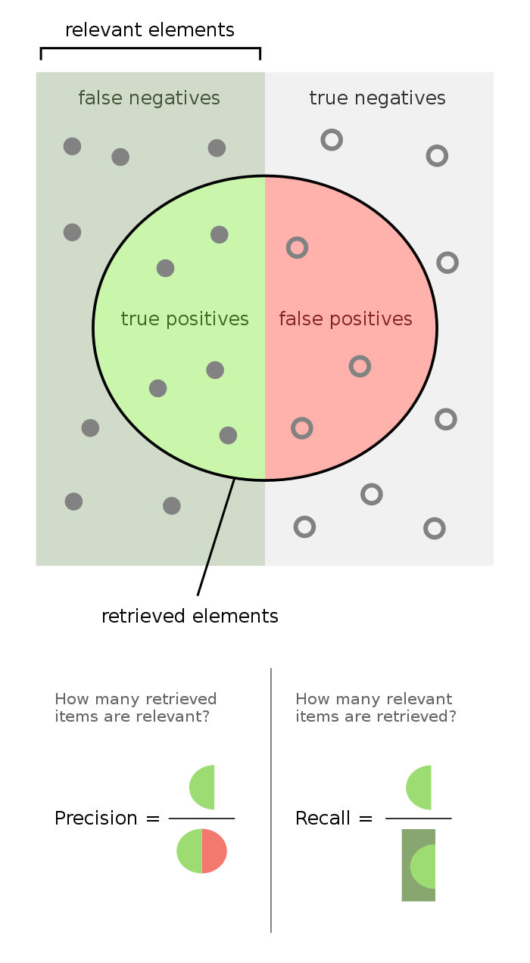
Employee Attrition: Performance Metrics
Recall was considered the most valuable metric, as a higher value captures most of the departing employees. False negatives were considered less important than false positives.
Precision - measures the accuracy of the positive predictions made by the model. In our case, a model with high precision is much better at predicting that the employee will leave the company.
Recall - measures the model's ability to identify all relevant elements. In our case, a model with high recall will capture most of the employees that intend to leave the company.
F1-score - the harmonic mean of precision and recall. It favors classifiers that have similar precision and recall.
Definitions by Géron (2022)
Notes:
Precision: Precision is the ratio of correctly predicted positive observations to the total predicted positives. It measures the accuracy of the positive predictions made by the model. Precision=True Positives/(True Positives + False Positives) Precision=True Positives + False Positives True Positives ​ Recall (Sensitivity or True Positive Rate): Recall is the ratio of correctly predicted positive observations to the total actual positives. It measures the model's ability to identify all relevant instances. Recall=True Positives/(True Positives + False Negatives) Recall=True Positives + False Negatives True Positives ​ The dilemma arises because increasing precision often leads to a decrease in recall, and vice versa. This is particularly evident when adjusting the threshold for classification. High Precision, Low Recall: Setting a high classification threshold tends to result in fewer positive predictions. However, those predictions are likely to be correct (high precision), but the model may miss many positive

Slide 15
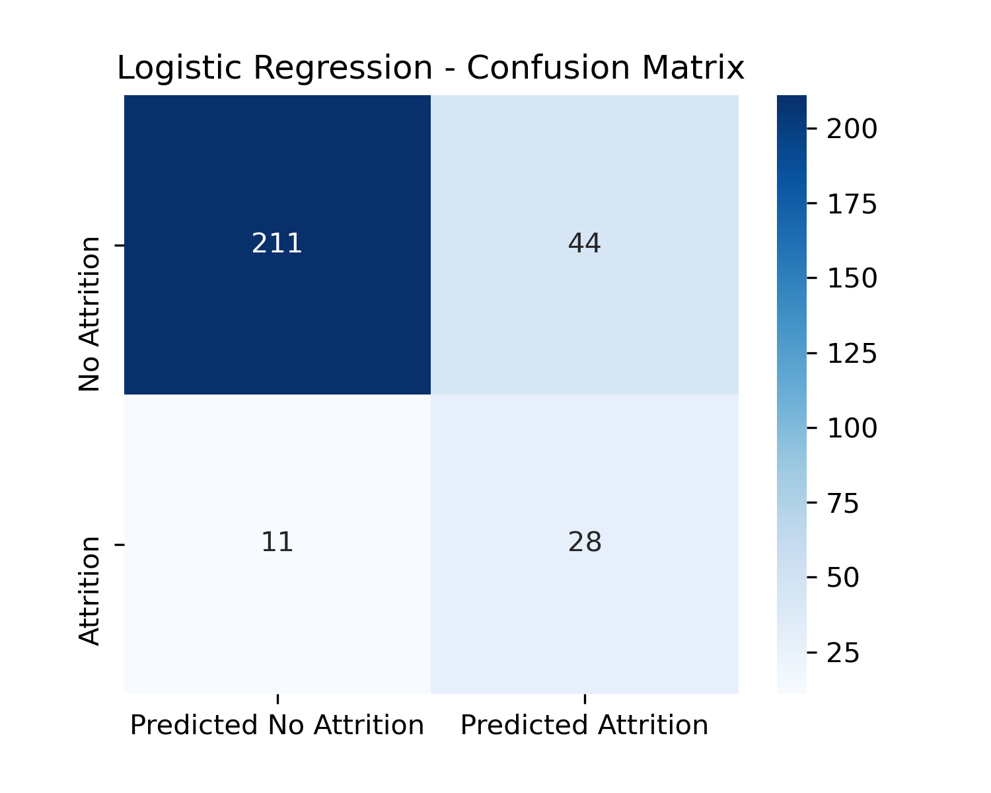
Employee Attrition: Predicting Attrition
Four supervised models* were tested. After hyperparameter tuning, Logistic Regression had the best performance.
Of the 39 cases of Attrition in the Test set, the final model can predict 28 attrition cases (72%), with 44 cases of false positives.
Results
 | Precision | Recall | F1-Score | Count
No Attrition | 0.95 | 0.83 | 0.88 | 255
Attrition | 0.39 | 0.72 | 0.50 | 39
Test set: 294 cases.
*Supervised models used: Logistic Regression, Support Vector Machine, XGBoost, Random Forest

Slide 16



Implementing the Predictive Model
Our model can be implemented in an HR Analytics platform that, along with other inputs, can help to track attrition and act before the employee leaves. It can also be used to design better HR practices within the company.
Other Signals
HR Analysis
Raw Data
Our Model
HR Dataset
HR Analytics Platform
HR Practices

Slide 17
Main Project Goals
Team Profile
Main Factors Causing Attrition
Employee Attrition Rate
Retention Strategies
Exploring Demographics, Lifestyle, Career Development
Identify main factors contributing to the employee’s decision to leave the company
Predicting future employee exits
Propose Retention Strategies that can be implemented to target the factors causing attrition

Slide 18
Proposed Employee Retention Strategies
Focus on the Young Employee type most likely to quit in the first years of their career
training and development
Identify Training needs and provide the appropriate Training to enhance the employee’s skills, motivating them to reach higher positions.
Career DEVELOPMENT PLAN
Define career development programs to provide employees with a clear idea of possible career trajectories.
Define Young Talent programs, targetting the younger employee profile.
Identify high-potential employees and offer professional growth opportunities that will position them for future leadership positions.

Slide 19
Proposed Employee Retention Strategies
Offering competitive base salaries or hourly wages is an essential factor in retaining employees
COMPENSATION PACKAGES
BENEFITS
Provide attractive compensation package that includes competitive salaries, performance-based bonuses, company stock-options, health insurance and retirement plans.
Offer corporate benefits such as company provided-lunches, on-site parking, a free day on the employee’s Birthday and Flexible work schedules.

Slide 20
Proposed Employee Retention Strategies
Employee retention is greatly influenced by initiatives that supports a good work-life balance
WORK-LIFE BALANCE
Working from home, decreasing travel time to the office.
POSITIVE WORK ENVIRONMENT
Build a positive workplace culture, which values flexibility, supports personal responsibilities and encourages a good work-life balance.
Foster open communication, collaboration and respect among employees.
Flexi-time, allowing the employee to balance their personal and professional life.
Provide resources to help the employee manage stress and maintain their wellbeing.

Slide 21
THANK YOU
EDSB23Q
André Pereira, 20221204@novaims.unl.pt
Francisco Antelo, 20221624 @novaims.unl.pt
Hortense Matos, 20222167 @novaims.unl.pt
Irina Keis, 20222168 @novaims.unl.pt

Slide 22
Back-up Slides

Slide 23
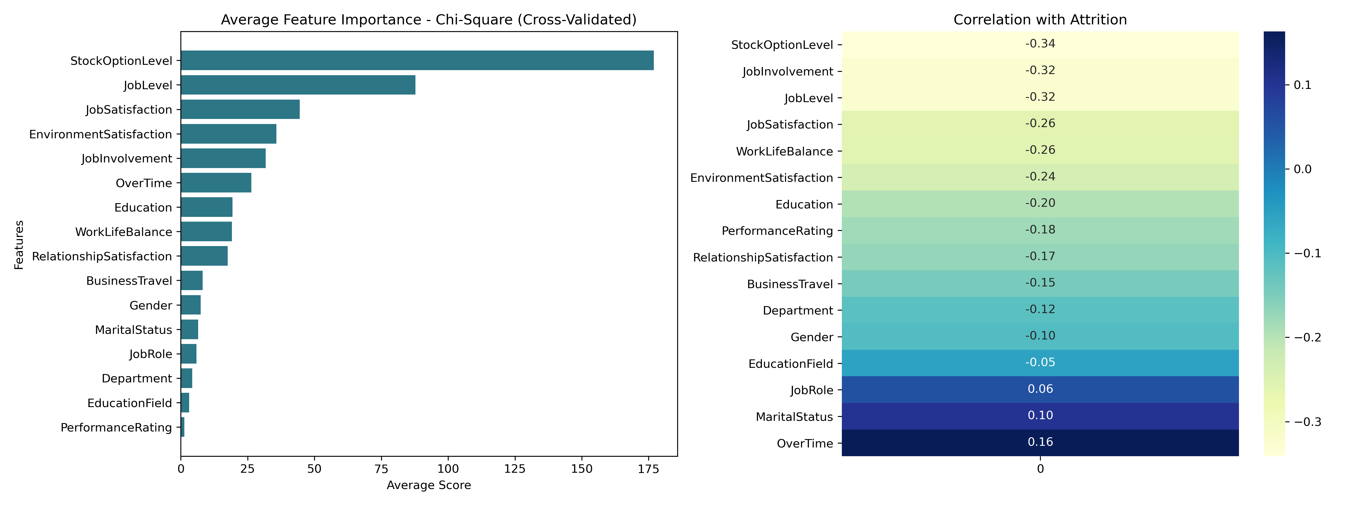
Feature Selection – Chi Square

Slide 24
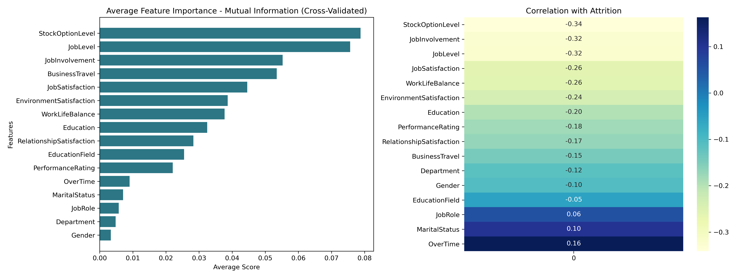
Feature Selection – Mutual Information

Slide 25
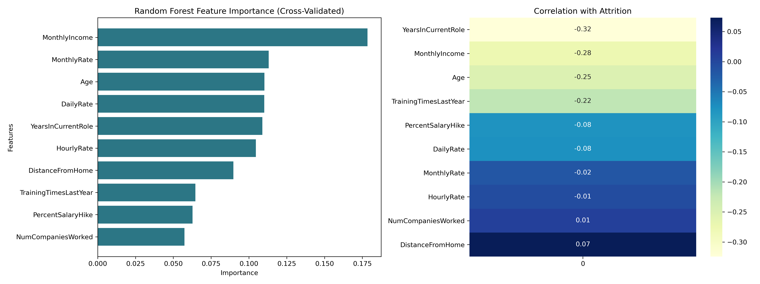
Feature Selection – Random Forest

Slide 26
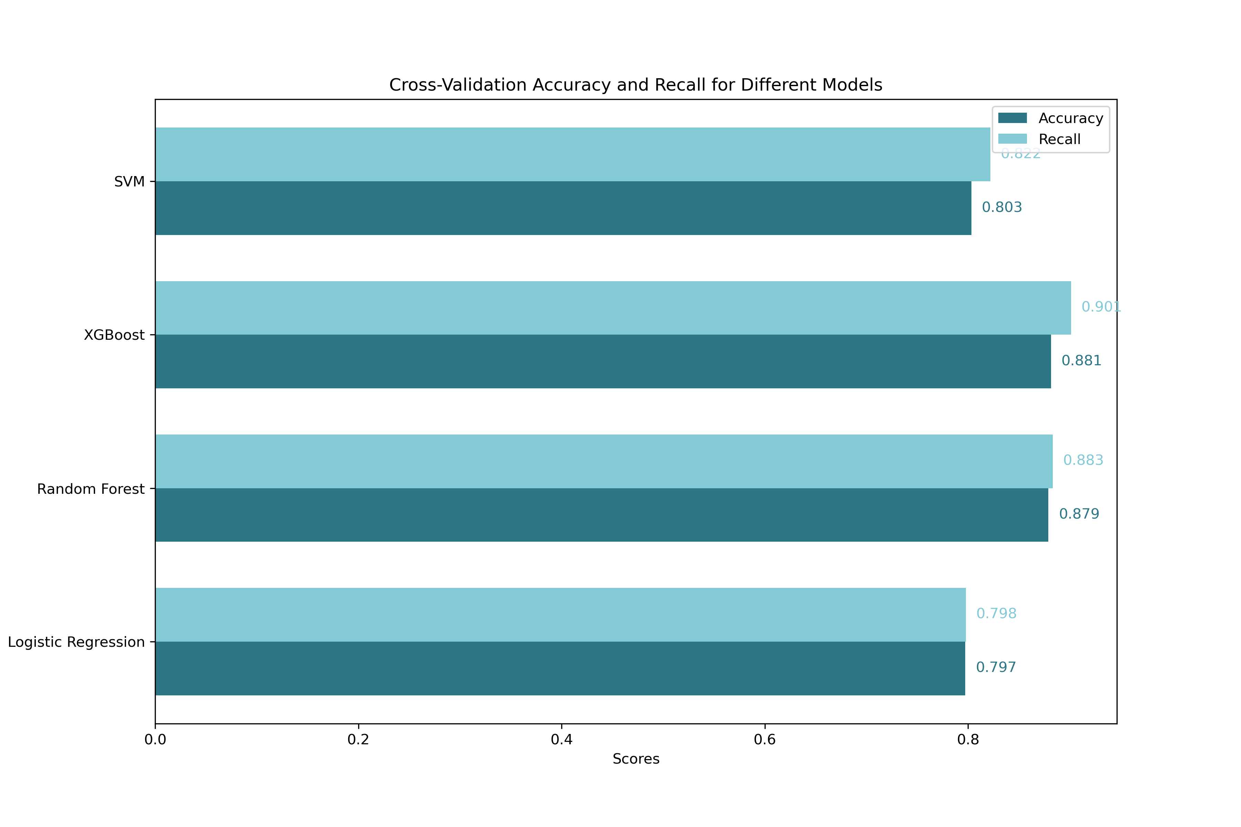
Model Performance – Training Set

Slide 27
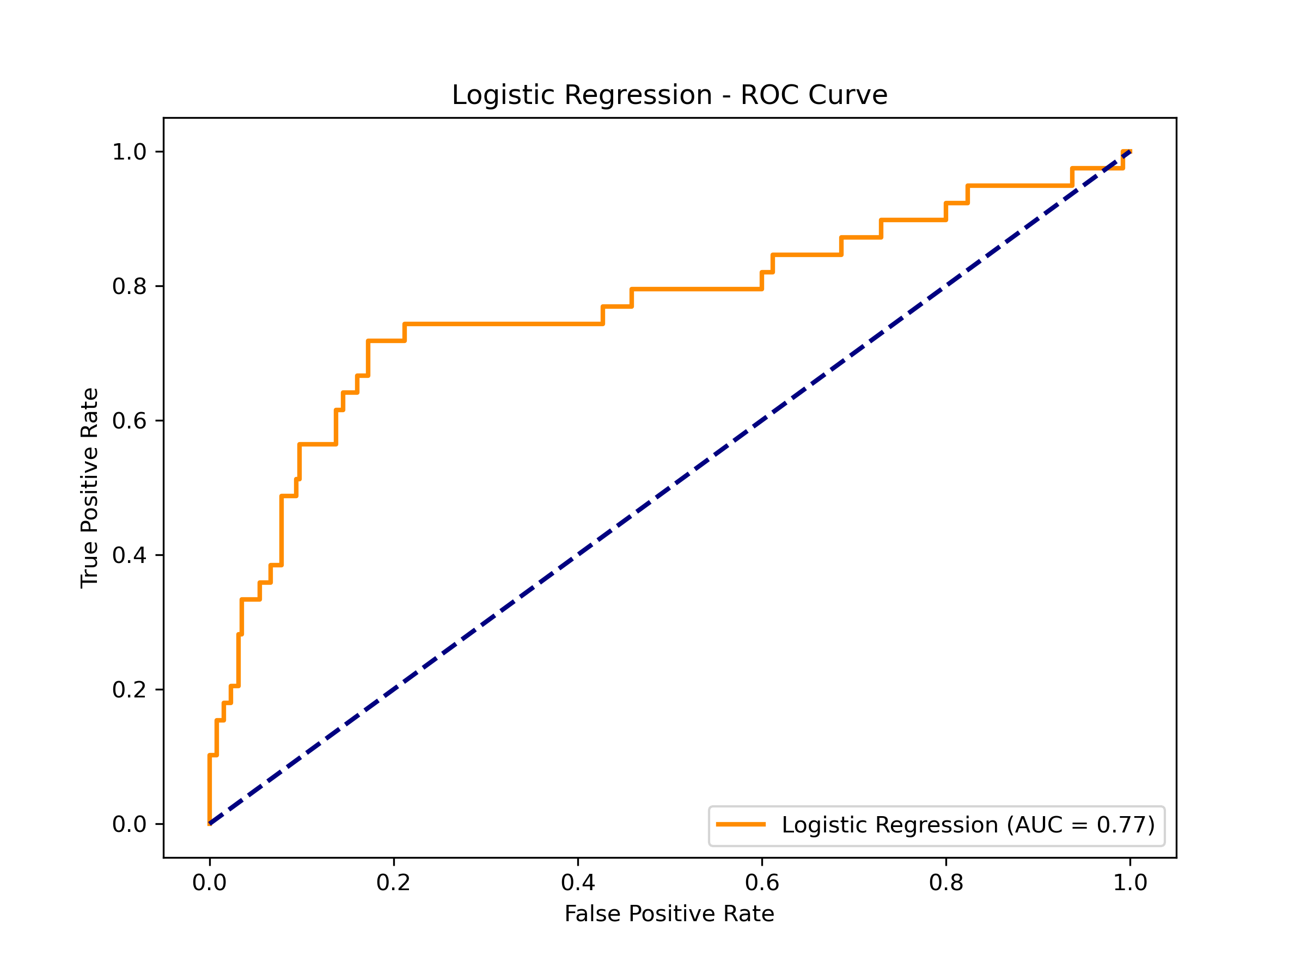
Model Performance – Test Set Logistic Regression

Slide 28
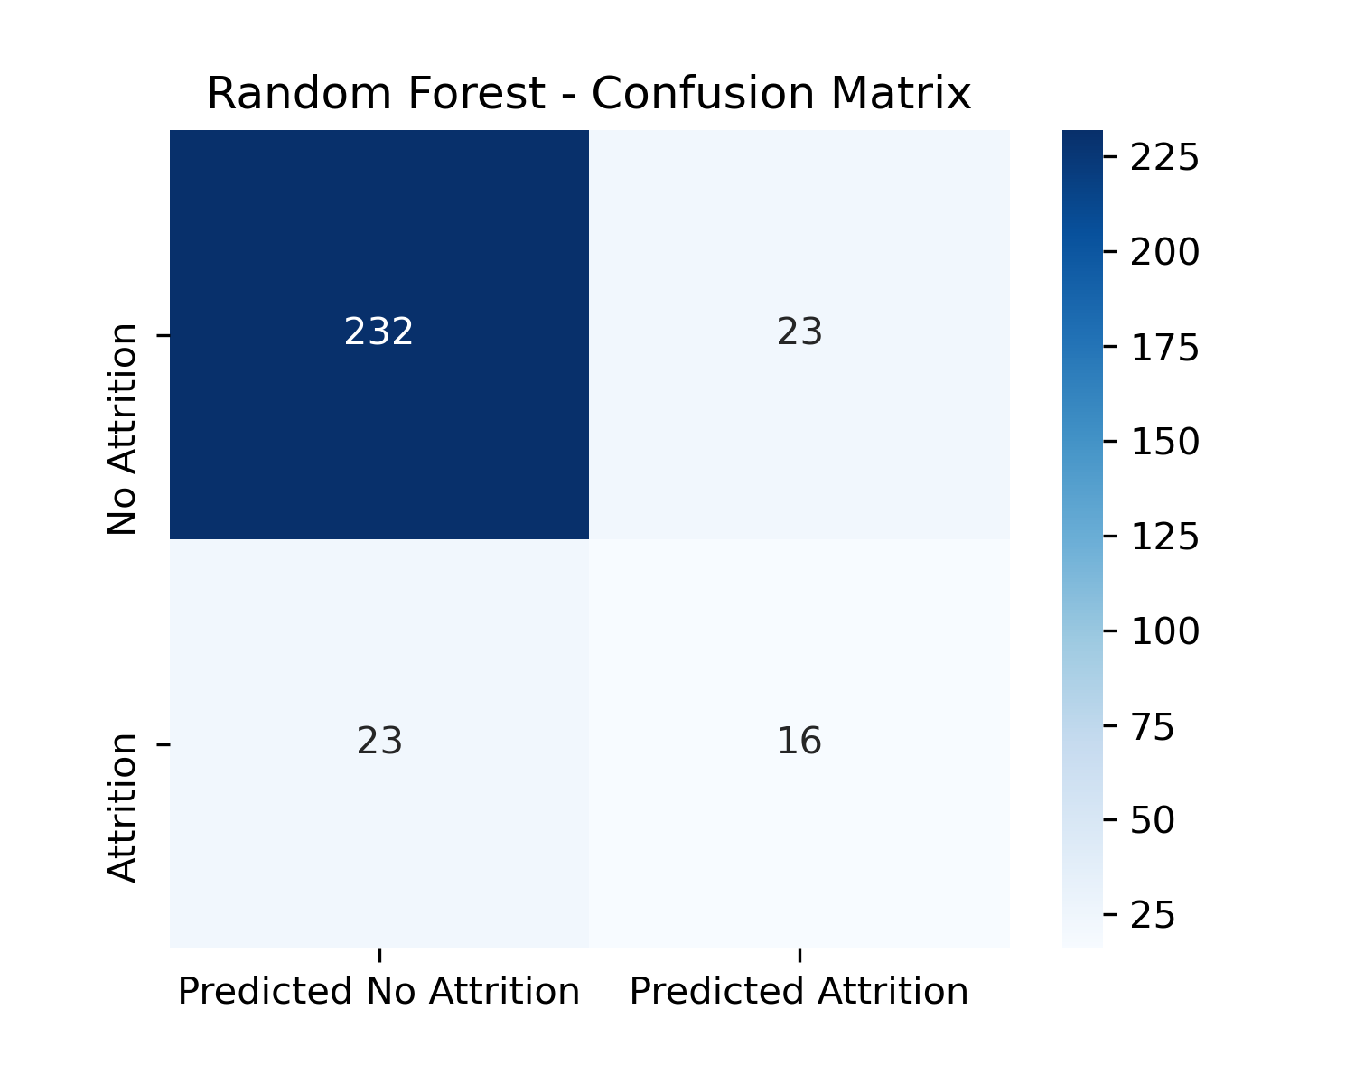
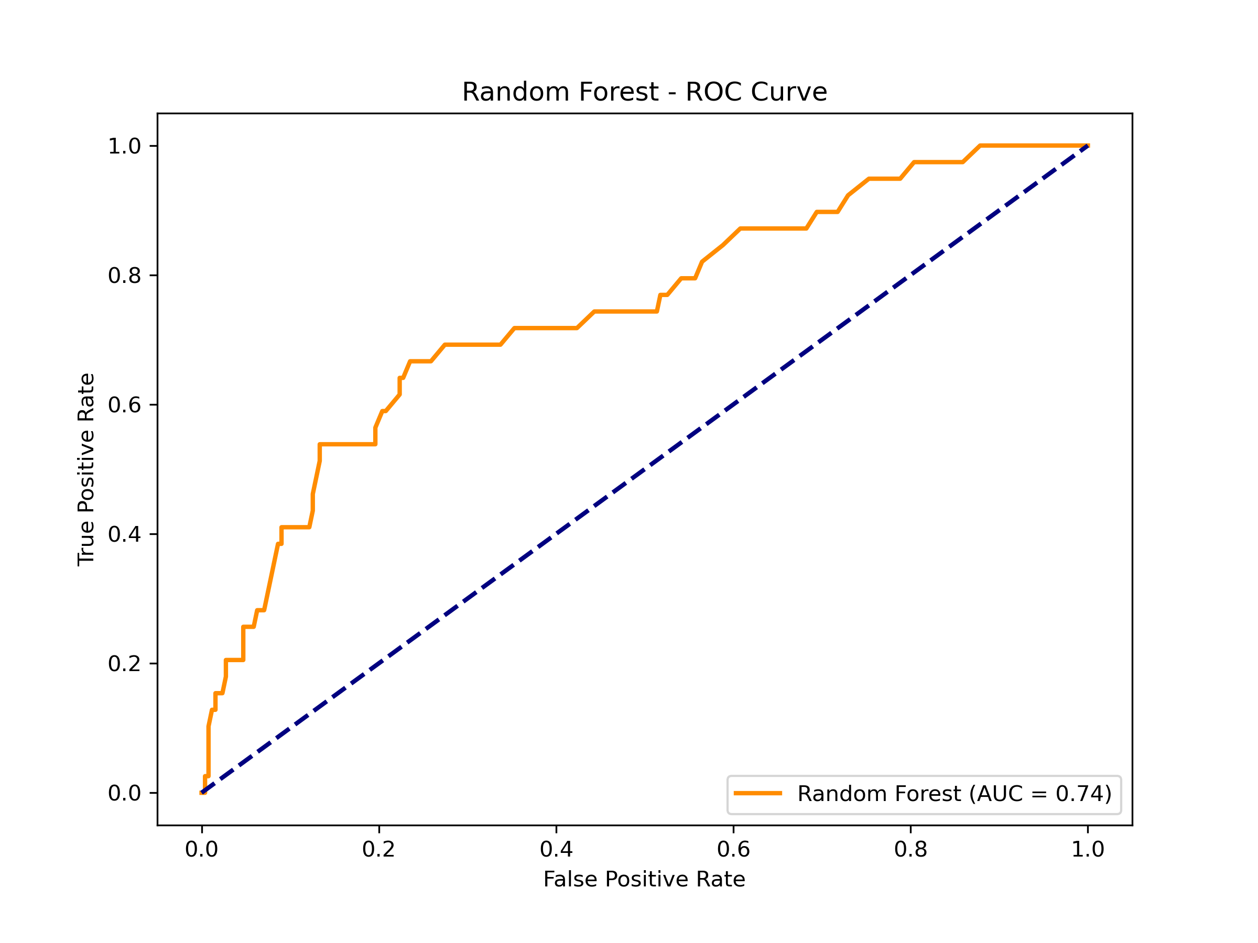
Model Performance – Test Set Random Forest

Slide 29
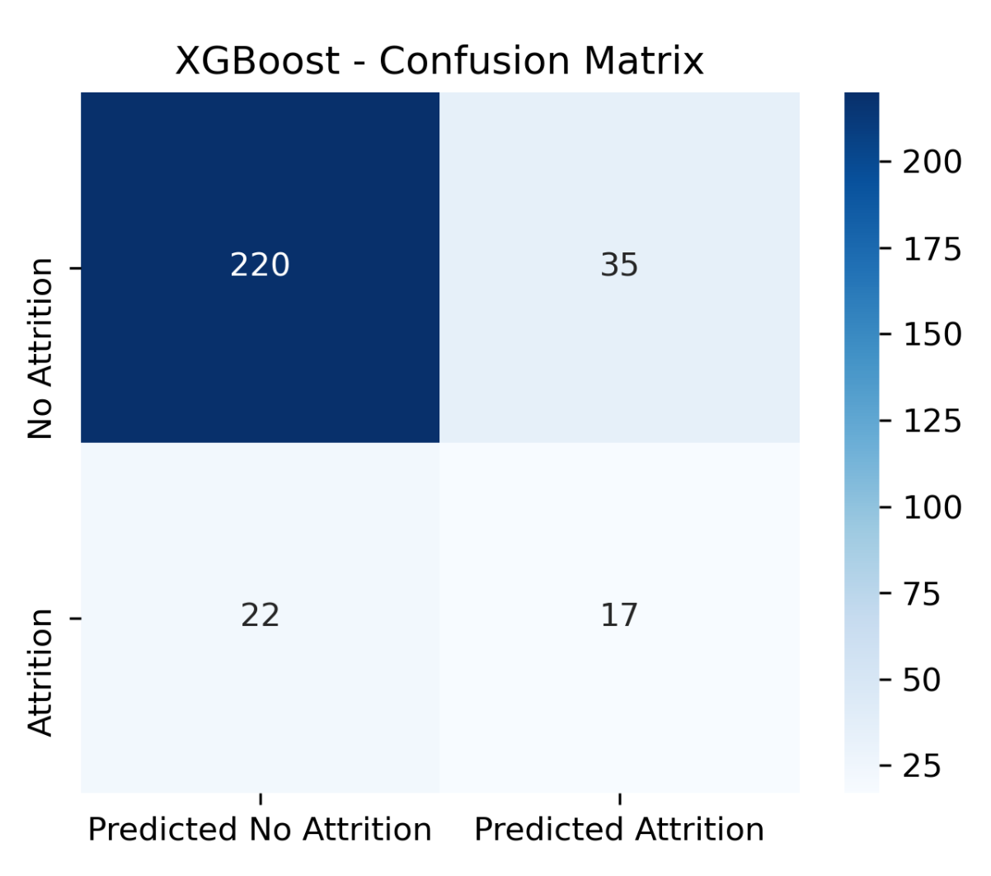
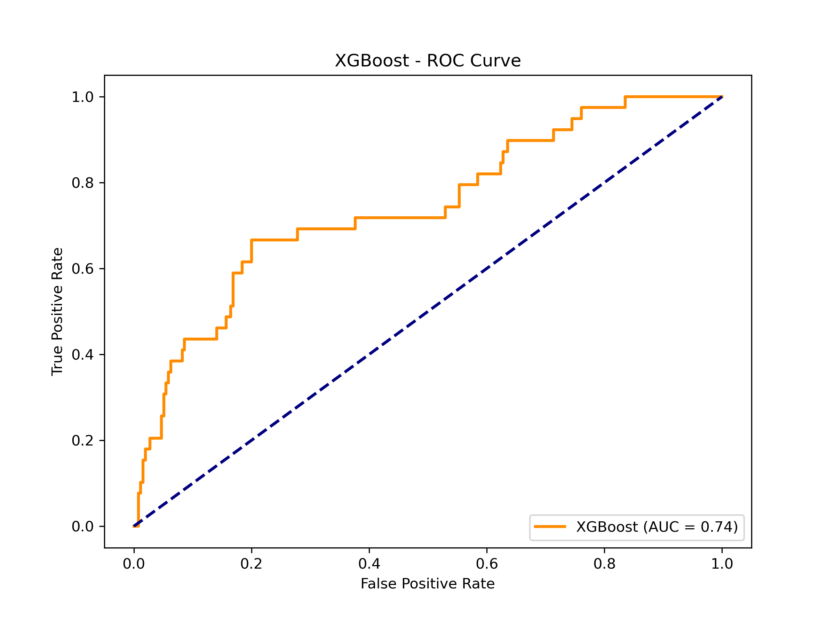
Model Performance – Test Set XGBoost

Slide 30

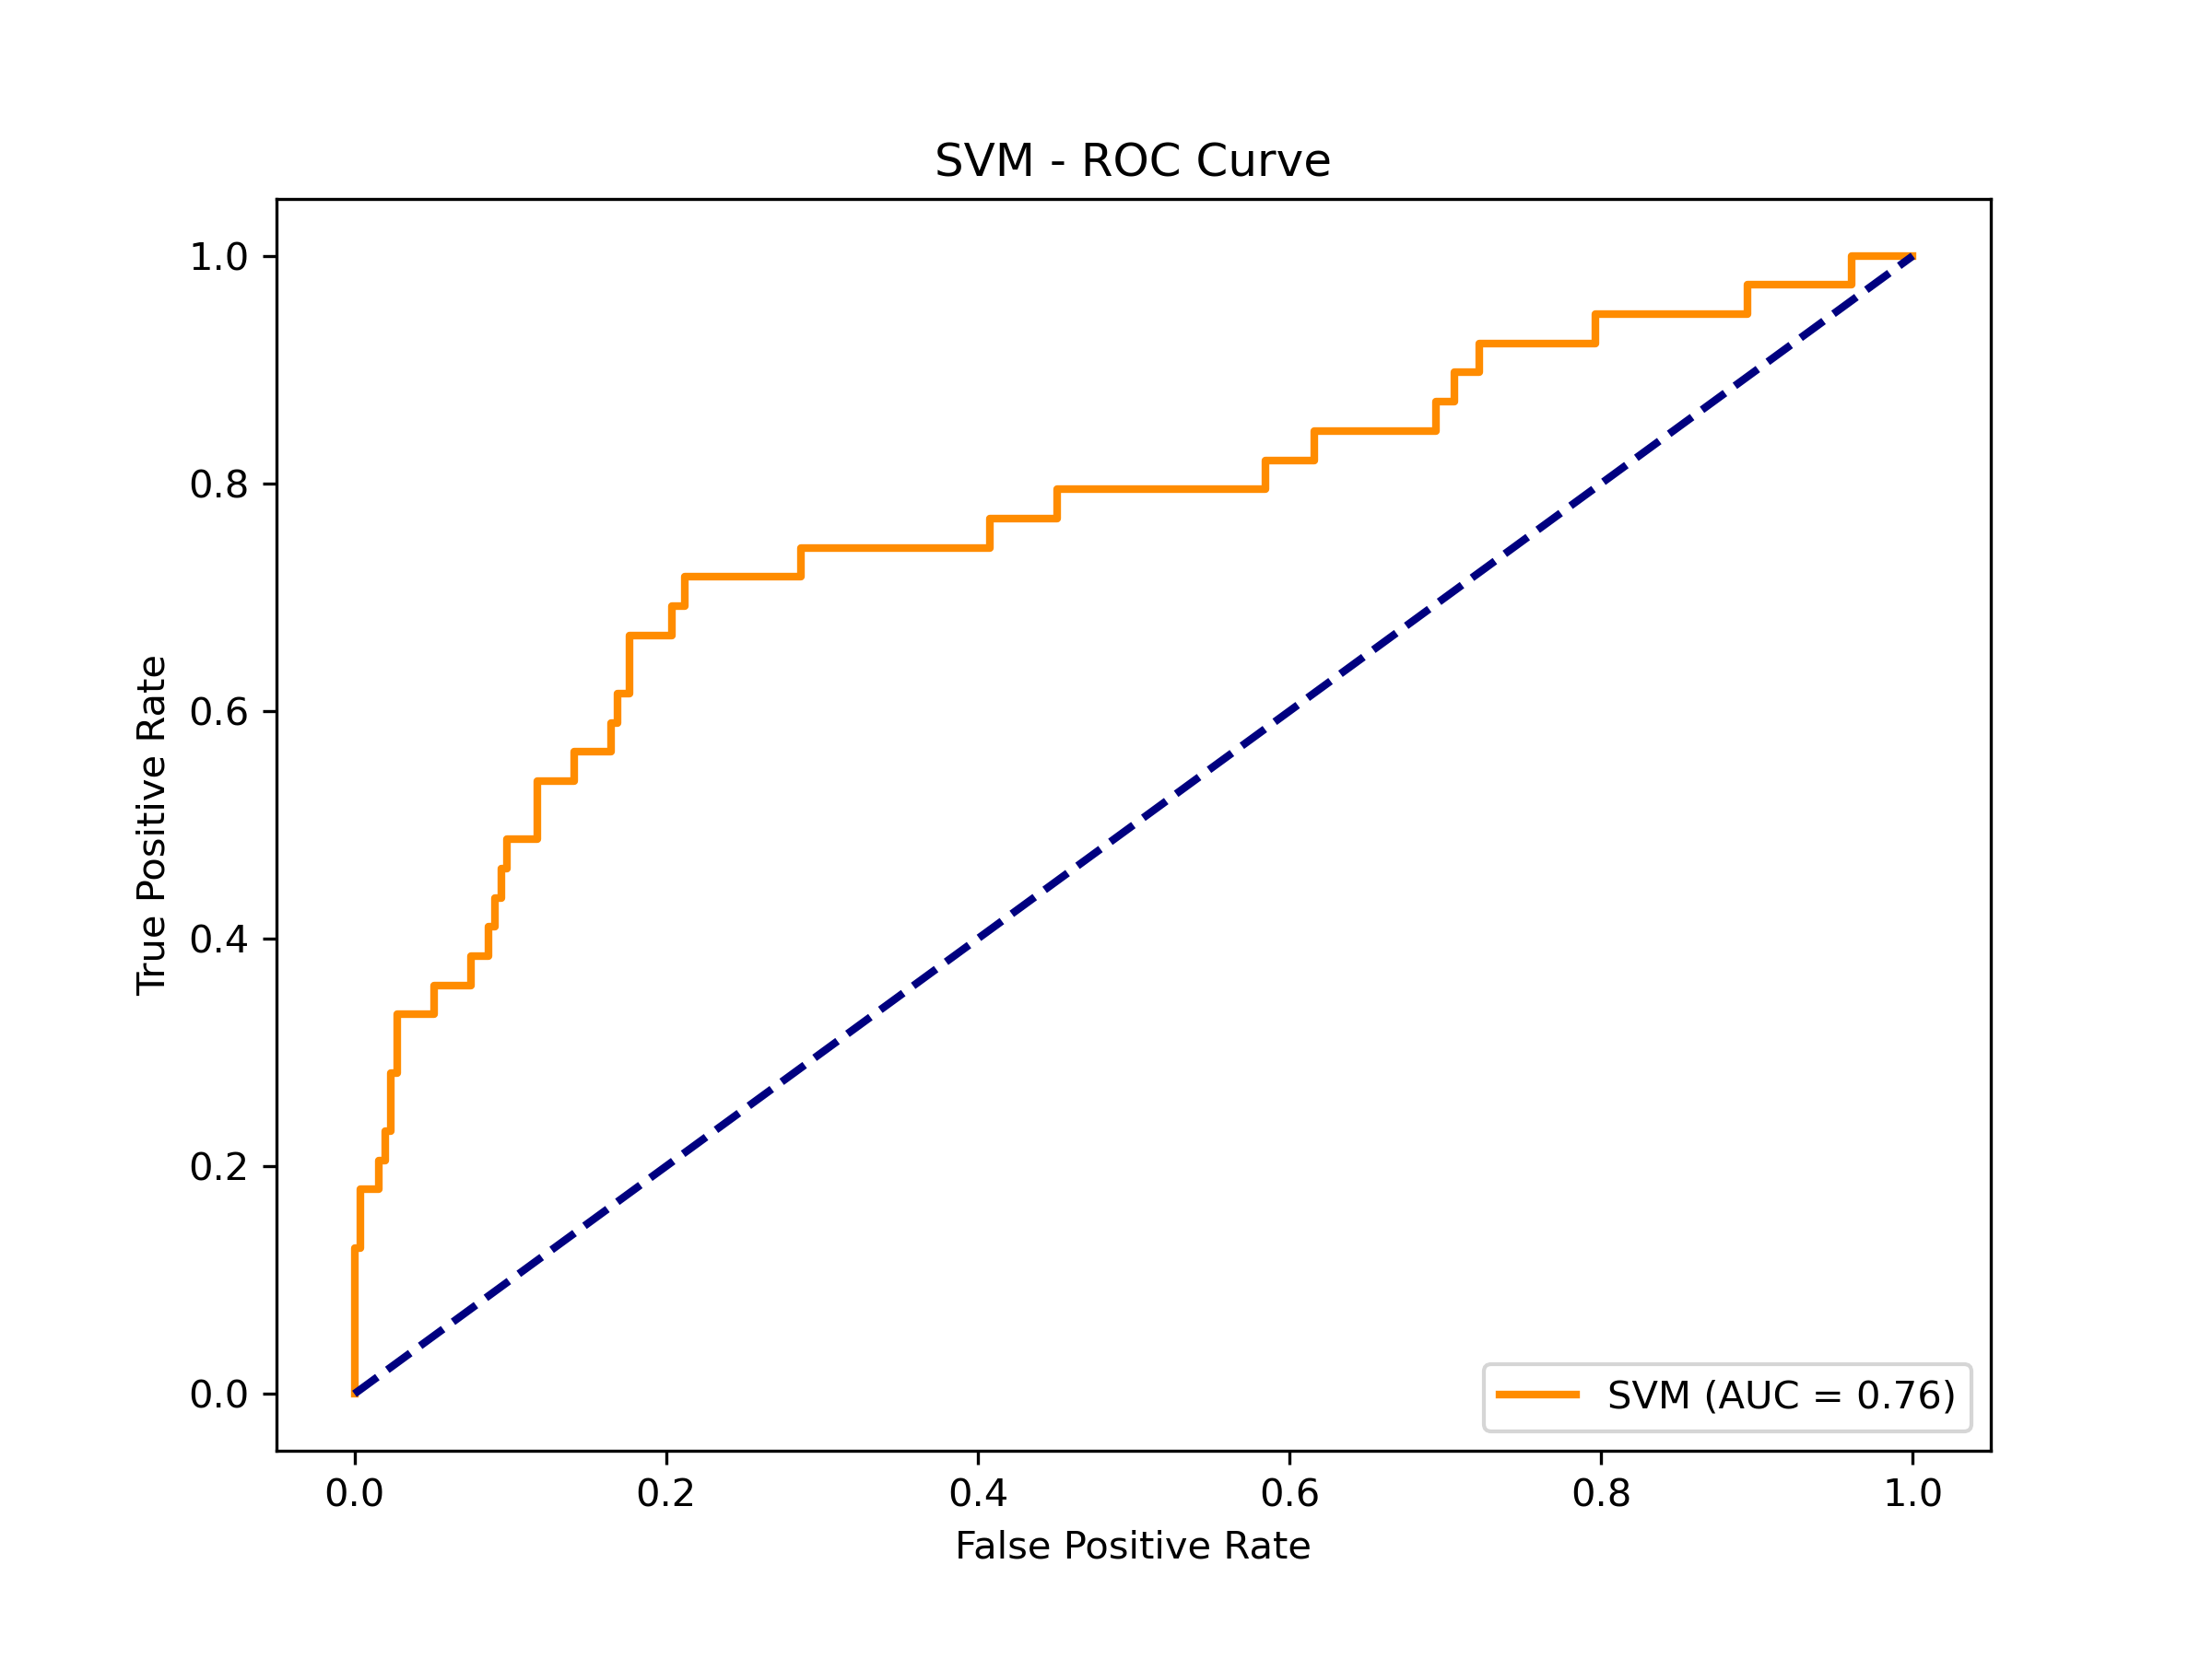
Model Performance – Test Set SVM

